Slide 1

Can self-similar processes be used for description of random curves having clearly expressed trend?
R.R. Nigmatullin
ПРИМЕНЕНИЕ ПРИНЦИПА САМОПОДОБИЯ ПРИ ОБРАБОТКЕ РАЗЛИЧНЫХ ДАННЫХ:
КАК ПОДОГНАТЬ ЛЮБУЮ СЛУЧАЙНУЮ КРИВУЮ, ИМЕЮЩУЮ ЧЕТКО ВЫРАЖЕННЫЙ ТРЕНД?
Нигматуллин Р.Р.
Профессор, Д.-ф.-м. наук
Казанский Национально-Исследовательский университет им. А.Н. Туполева, Казань.
Кафедра РИИТ
¹⁾Kazan National Research Technical University named after A.N. Tupolev,
Radioelectronics and Informative Measurements Techniques department,
Karl Marx str.10, 420111, Kazan, Russian Federation.

Slide 2
Motivation
Abstract : This work was greatly influenced by the interesting research of the French scientist (Jocelyn Sabatier) who demonstrated in his recent book [1] that it is important to distinguish between "fractal models" and "fractal" (power-law) behavior. According to the self-similarity principle (SSP), the author of this study enables completely distinguish between independent "fractal" (power-law) behavior and "fractal models," which result from the solution of equations incorporating non-integer differentiation/integration operators.
One can show that many random curves resemble one another and, therefore, they can be fitted by functions with real and complex-conjugated power-law exponents. The Bellman's inequality can be used to demonstrate that the generalized geometric mean (GGM), not the arithmetic mean, which is typically recognized as the fundamental criterion in the signal processing field, corresponds to the global fitting minimum. To highlight the efficiency of the proposed algorithms, the proposed formulas are applied to photodiode noise that clearly demonstrate the self-similar properties and , therefore, can be fitted by a combination of log-periodic functions.

Slide 3

Three types of errors
(Equipment +Exp.methods)-measurement errors
Model Errors
Treatment Errors
Principle
Controllable errors

Slide 4
Plan of the report:
The formulation of the problem
2. Section 2 – basic formulation of the theory
3. Section 3 – Description of the algorithm
4. Results and Discussion
5. Necessary References

Slide 5
“Fractal” – (Power-law) behavior
with log-periodic oscillations.
Self-Similarity Principle
“Fractal models” ?
Based on Non-integer integral /derivative operators
2. The basic of the theory
Example 1. W-M function The generalized W-M function
(1)
(2)
In equation (2) the variable z can coincide with time t, complex frequency iω, Laplace complex parameter p etc. The phase ϕ in (2) takes into account the fact that parameter b can accept negative value (ϕ=π) or can be complex (ϕ≠0). For further manipulations with expression (2) we simply replace (be^{iϕ}) → b implying that number b can accept any arbitrary value (positive, negative or even complex). The complex function f(z) has the following decompositions:

Slide 6

(3)
(4)
This function was analyzed in paper [8]. 4 cases are possible:
Case a) when b, ξ > 1. The contribution of two terms in (4) becomes negligible when ξ > b.
Case b) when b, ξ < 1. The contribution of two terms in (4) becomes negligible when ξ < b.
Case c) when b > 1, ξ < 1. For this case it is necessary bξ <1.
Case d) when b < 1, ξ > 1. For this case it is necessary bξ >1.

Slide 7
Therefore, one can write approximately
(5)
Conclusion – the generalized W-M function is self-similar.
Let us suppose that initial function represents itself a linear combination of 3 generalized W-M functions of the type (2).
(6)
We assume that "microscopic" functions f_{k}(z) fulfil comparable decompositions and that the evaluations of each sum S_{k}(z) given above are still accurate. Therefore, using approximate relationship (5) one can write

Slide 8
(7)
Here F_{k}(z)=F(zξ^{k}), k=0,1,2, r_{k}=(b_{k})⁻¹. One can dissolve this system (7) relatively the unknown sums S_{k}(z) and substitute them into the function F₃(z)
(8)
After some algebraic manipulations one can obtain the following self-similar functional equation
(9)
(10)

Slide 9
In order to satisfy to condition (10) one can identify one root, for example r₃ with the unit value, i.e. r₃ =1. In this case we have
(11)
Functional equation (9) relatively unknown function F(z) can be solved if one can find the solution in the form
(12)
The substitution of inoculating solution (12) into (9) lets to represent the final solution in the form
(13)
Root r₃ = 1
For practical purposes it is necessary to give solution for two self-similar combinations

Slide 10
(14)
(15)
2. CPE or reind/recap elements
For this aim we represent the complex impedance for a combination of RCL passive elements in the form
(16)
(17)

Slide 11
These decompositions are similar to the previous supposition (3). We should note here that expression (17) is valid for Cases a) and b) considered above.
Therefore, if the passive RCL elements are similar to each other and satisfy to the scaling property R_{n} =R₀b^{n} then one might expect the appearance of a CPE with power-law behavior accompanied always by complex-conjugated addings.
3. Oustaloup product
(18)
(19)
Here z- is an arbitrary complex variable z= iω, a₁,b₁ > 0 are some positive constants, the constant
can be complex and accept any value. It is easy to note that the product (19) satisfies to the following relationship
(20)
N>>1
(21)

Slide 12
(22a)
(22b)

Slide 13
(23)
At N >>1
(24)
The further analysis of approximate expressions in (24) can be analyzed in complete analogy with previous expressions (7) (K=3), (14) (K=2) that lead again to desired linear equations (9) and (15).
For us it is important to stress also one fact. On the mesoscale region any CPE is accompanied by complex-conjugated supplements. In some materials modulated by RCL models the detected impedance can be described by a combination of power-law exponents similar to expression (13) containing two-power law and more exponents. Obviously, expression (9) can be generalized. Let us suppose that from the SSP one can write the following relationship

Slide 14
My question: if the weighting factors depends on z, i.e. w_{q}(z) is it possible to receive some analytical solution?
The question is open.
(25)
where the previous measurements form a specific self-similar memory. The complete solution of (25) one can find in [4].
(27)
(26)
For a negative root from (27) solution (26) should be rewritten as
(28)

Slide 15
If founded root r_{g} (r_{g} > 0) from (27) is the g-fold degenerated then the solution for F(z) is written as
(29)
Finally, for completeness, we should write the solution of (25) for complex-conjugated roots
(30)
We would like to stress the following fact. Irrespective to connection with fractional integral of different type the power-law dependencies including the complex power-law part are appeared in the result of solution of the functional equation (25) in the mesoscale region. That is why the dielectric spectroscopy can be considered as collective motion of atoms/molecules in the mesoscale region. We want to stress that the SSP is the basic one for generations of a family of different power-law dependencies that cannot be connected directly with the conventional fractional integral of the R-L type or its modifications.

Slide 16
Let us make next step and consider the nonlinear functional equation of the type
(31)
where nonlinear parameter s is located presumably in the interval
and covers the well-known mean values for s = –1 (harmonic mean), s = 0 (geometric mean) and s = 1 (arithmetic mean). We suppose also that all functions figuring in (25) are positive. The case s=0 is considered as the limiting case
(32)
Taking into account the Bellman's inequality [5] that that valid for any positive values and including functions also one can conclude that
(33)

Slide 17
Inequality (33) for the normalized values w_{q} is the basic one. It implies that true mean is tightly associated with the generalized geometric mean (GGM) covering a part of self-similar processes (q = 0,1,…,L) and not with arithmetic mean that it is conventionally accepted in the signal processing theory. Another important remark is related to the value of the scaling parameter ξ.
The value of ξ accepts arbitrary value and can be located presumably inside the interval Rg(ln(x)) = max(lnx) – min(lnx), i.e. lnξ < Rg(lnx) or can exceed it. Here we consider x=Re(z). If the first condition is satisfied then this case one determines as "internal fractality or self-similarity". In the opposite case lnξ > Rg(lnx) we have "external fractality". A possible interval for lnξ, where hidden scaling can be located, is determined approximately from inequality
(34)
3. Detection of the "Hidden" Power-Law Dependencies from Real Data
Before analyzing the measured data, we want to make one important remark. One can prove at least qualitatively that any random curve J(y) expressed in the form of a clearly expressed trend will have self-similar behavior. Really, let us imagine that initial curve J(y) has N data points. From these points we want to select as minimum b=3 local points, viz., Ymx=max(y_{b}), Ymn= mean(y_{b}) and Ymin= min(y_{b}). These 3 important points are invariant relatively all possible permutations among N data points. In the result of this transformation the initial integral curve J(y) is compressed in 3 times and the compressed curve having N/3 data points is not changed practically.

Slide 18
(35)
(36)
How to fix self-similar property from initial “noisy” data?
1. Let one can consider any "noisy" component that do not have clearly expressed trend. One can create a clearly expressed trend with the help of integration procedure
(37)

Slide 19
The solution of this functional (36) equation can be expressed in the form of log-periodic decomposition
2.
(38)
Let us define the scaling operator by definition
(39)
Based on this definition one can rewrite (36) as
(40)
In general, if the root a=1 in (35) is the k-fold degenerated then one can write the following general relationship
(41)

Slide 20


The solution of this functional equation (41) can be expressed as (see the general expression (29))
(42)
In practice, verification of solution (42) on real data shows that the case K=1 does not provide the acceptable fit, while the case K=2 is proved to be completely satisfactory. Opening solution (42) for K=2 one can represent the solution in the following equivalent form
The basic fitting
Function!
(43)
If the integral curve can be expressed by expression (43) then the fitting parameters are expressed by parameters
Another important remark is related to the value of the scaling parameter ξ. This parameter accepts arbitrary value and can be located
presumably inside the interval Rg(ln(x)) = max(lnx) – min(lnx), i.e. lnξ < Rg(lnx) or can exceed it. If the first condition is satisfied, then this case is determined as "internal fractality or self-similarity". In the opposite case lnξ > Rg(lnx), we have "external fractality". A possible interval for lnξ, where hidden optimal scaling can be located, is determined approximately from the inequality (34) for K=2.

Slide 21
The evaluation of the true value of the nonlinear parameter lnξ from the minimal fitting error value is explained based on the minimization of the fitting error.
(44)
Another question can be posed is the following. Is it linear functional equation of (41) is optimal or not? Let us make the next step and consider the nonlinear functional equation of the type (31). Taking into account the Bellman's inequality [2] that is valid for any positive values and also including positive functions, located tin the first and second quarters of the OXY axes one can conclude that
(45)
It means that for the case K=2 the generalized geometric mean (GGM) being expressed in the form
(46)
corresponds to the global fitting minimum. For the fitting purposes it is necessary to take the natural logarithm from (46) and consider the fitting function Ly₂(x) = ln(y₂(x)). Taking into account the Bellman's inequality (45) it is necessary to shift the initial function into the positive region

Slide 22
(47)
Therefore, all fitting functions can be prepared in accordance with expressions (46) and (47) and simultaneously the fitting functions as Jy₂(x) and its natural logarithm
(48)
For input variable x we choose a "universal" uniform and normalized to the unit value the following scale
(49)
The presentation of input data vs. x_{j} is very convenient because it is easy to restore any required scale identifying the initial x₀ and final x_{N} limiting parameters, only. Below, we want to illustrate in some key figures how the proposed algorithm works.

Slide 23
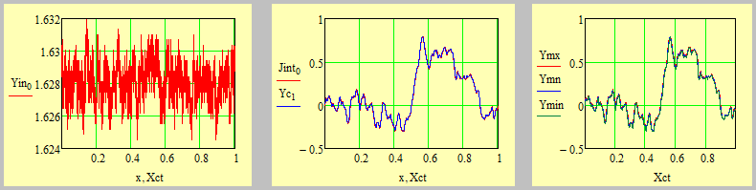
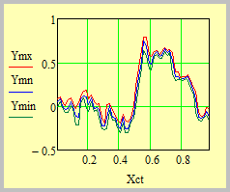

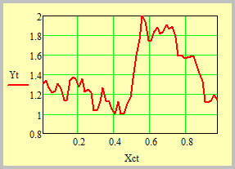
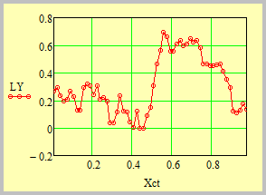
3.1 The verification on real data
From the left to the right: Fig.1(a) – initial noise recorded from the photodiode. (b) Integral curve Jint(0), containing N= 8998 data points. Yc(1) – the same curve compressed in 25 times. Xct = 358 data points. (c) the compressed triad (Ymx, Ymn, Ymin), (d) The curved compressed in 150 times. The distortions are seen clearly.
On the right – ln(Yt).
The shifted function which is ready for the fitting purposes.

Slide 24
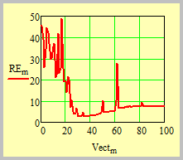
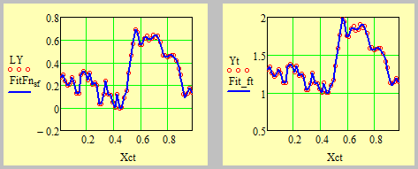

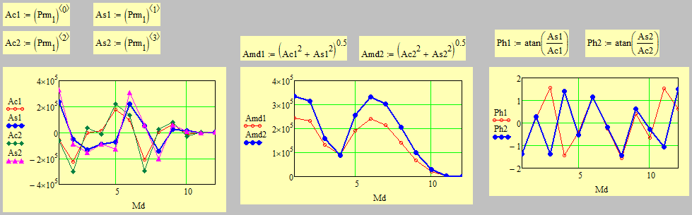
Calсulation of the optimal lnξ optimal
S=33, RE=2.21
The fit of the compressed curves. On the right – the fit shifted curve.
On the left – ln(Yt)
The calculated distribution of the amplitudes that figure
In expression (43).

Slide 25
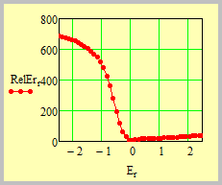
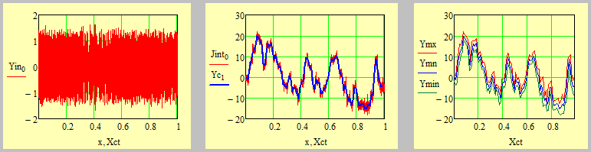
Verification of the Bellman’s inequality
s=0, RelEr=4.986
Example 2. Radio receiver data
Initial data
Blue line – compressed data b=20.
Three distributions

Slide 26
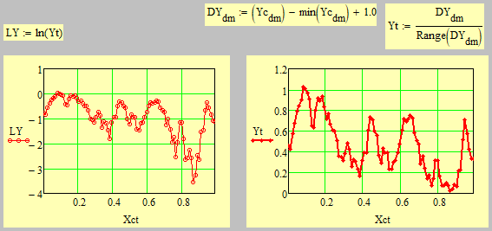
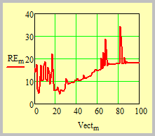
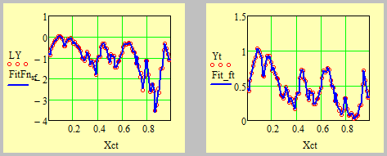
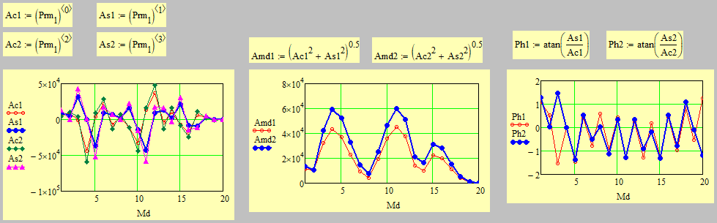
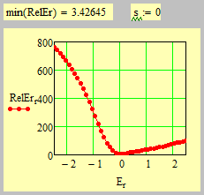
S=24, 4.31
The fit by expression (43)

Slide 27
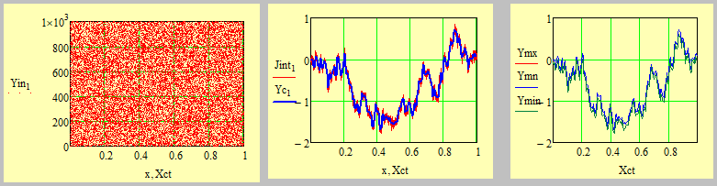
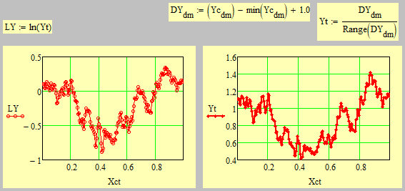
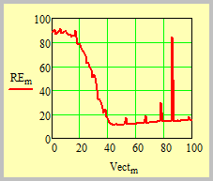
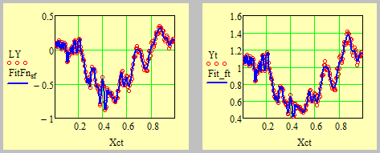

Trans-numbers E=2.718 281 828 459 045 235 360…→0.718, 0.281, 0.828, 0.459, 0.045, 0.235, 0. 36, …
Compression parameter b=100

Slide 28
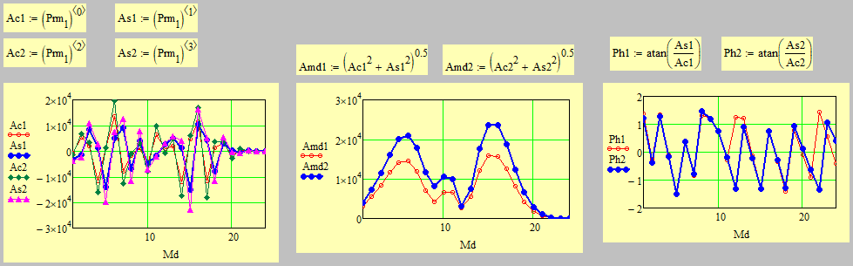
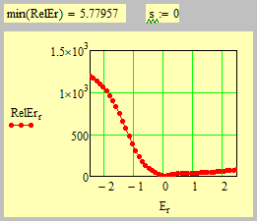
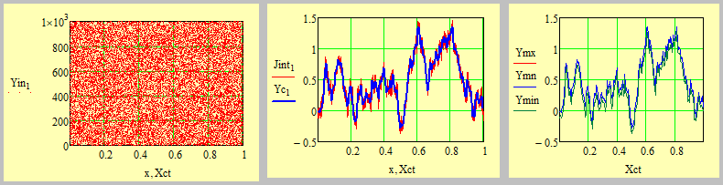
b=100

Slide 29
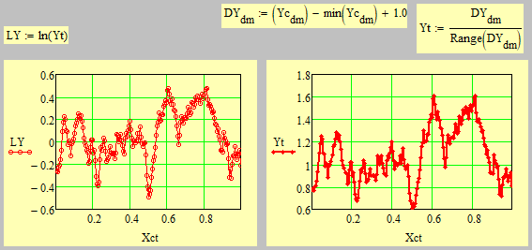
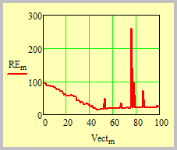
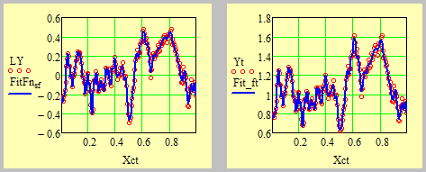
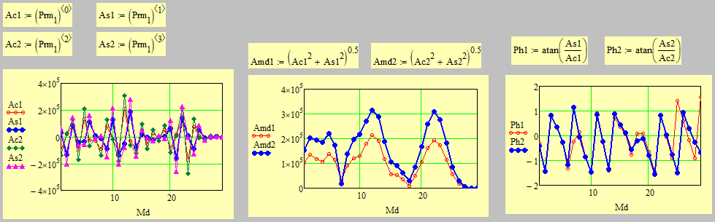
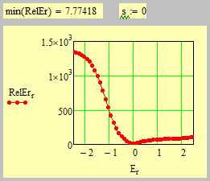

Slide 30
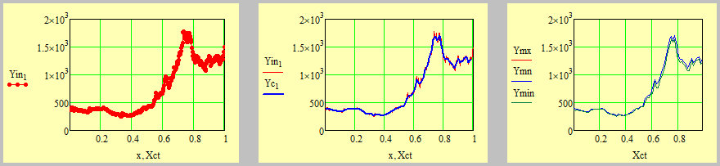
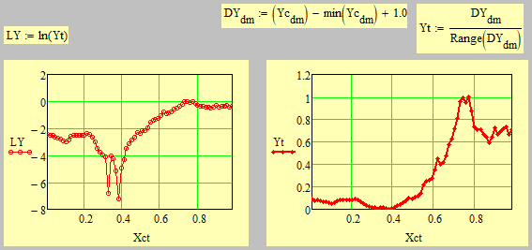
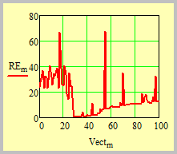
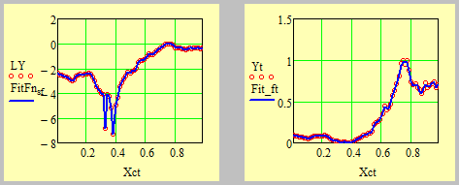

Economic data – prices for Au-Gold – 360 data points compression parameters b=5

Slide 31
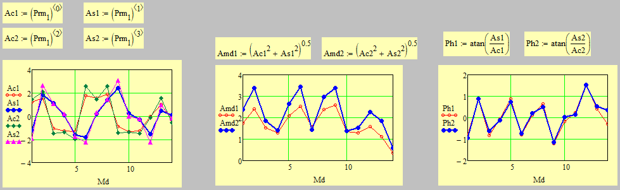
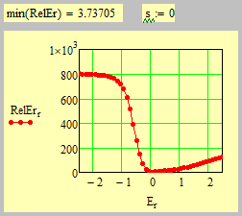
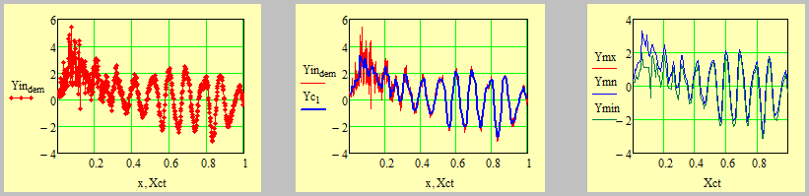
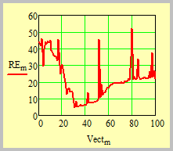
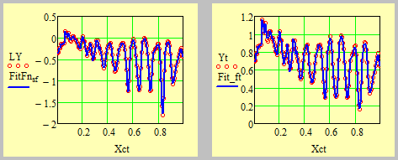
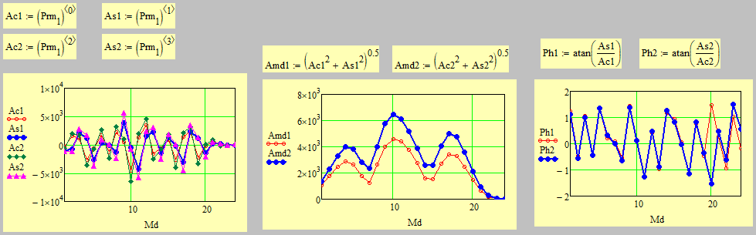
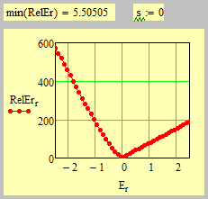
Geo-data N=698 b=5.

Slide 32
Finishing this section, one can give another "reading" of the SSP. Let us introduce the scaling operator as
If the scaling operator's link in equation is justified then equation on the right "enables" immediately to provide all potential "scalings" that may be applied to the system under consideration.
Generalization of the 1-D SSP for 3D-case.
Problem: How to solve these functional equations?
My question: how to solve these functional equations analytically for the given r(z) and Φ(z)?

Slide 33
4. Results and Discussions
In this presentation, one can show how the SSP leads to a broad class of power-law dependencies. For linear circumstances, this concept is expressed by expression (25), whereas for nonlinear cases, it is expressed by expression (31).
2. Interesting conclusion supported by numerical calculations: actually a wide class (?) of random curves having clearly expressed trends can be fitted by functions containing power-law exponents and couple of log-periodic functions. (This statement needs a special research…). Many random curves are self-similar and can be fitted by the GGM function.
3. A weak point of the modern FC: strong mathematics and absence of the clear interpretation of the power-law exponents.
In many common equations like diffusion, Schrödinger, wave, etc., the majority of researchers start with mathematical generalizations of fractional integrals/derivatives and "swap out" integer operators with non-integer ones. They can get the necessary power-law dependencies as a result of this replacement.

Slide 34
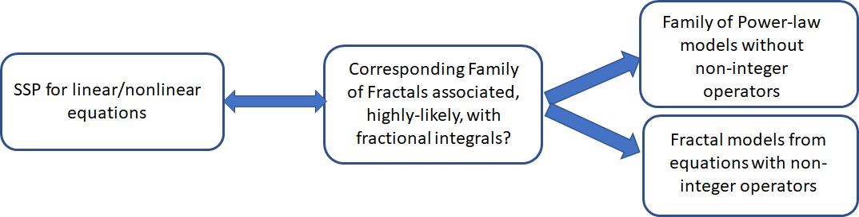
4. Bellman’s inequality (33) plays an important role. In many cases, when the linear combination of the constants are weighted
then the GGM corresponds to the fitting minima and not the arithmetic mean as it is conventionally expected in the signal processing area.
SSP
Corresponding Non-int Operator?

Slide 35
Basic References
[1] J. Sabatier, Ch. Farges and V. Tartaglione. Fractional Behaviours Modelling, Springer, https://doi.org/10.1007/978-3-030-96749-9. In the issue: Intelligent Systems, Control and Automation: Science and Engineering, v.101., (2022).
[2] J. Sabatier, Modelling Fractional Behaviours Without Fractional Models, Frontiers in Control Engineering, Vol. 2, 2021, https://www.frontiersin.org/articles/10.3389/fcteg.2021.716110 .
[3] V. Tartaglione, C. Farges, J. Sabatier, Nonlinear dynamical modeling of adsorption and desorption processes with power-law kinetics: Application to CO2 capture, Physical Review E, Vol. 102, p 052102, 2020
[4] Raoul R. Nigmatullin1 José Tenreiro Machado, Rui Menezes. Self-similarity principle: the reduced description of randomness. Cent. Eur. J. Phys., DOI: 10.2478/s11534-013-0181-9 (2013).
[5] Beckenbach, E. F., & Bellman, R. Inequalities (Vol. 30). Springer Science & Business Media (2012).
[6] Mandelbrot B.B. The Fractal Geometry of Nature. W.H. Freeman, New York, 1982.
[7] J.Feder. Fractals. Plenum Press, New York and London, 1988
[8] R.R. Nigmatullin and A.S. Vorobev, Discrete Geometrical Invariants: How to Differentiate the Pattern Sequences from the Tested Ones? – Published in the Proceedings of the ICFDA19 conference. Springer Proceedings in Mathematics & Statistics, January 2019.

Slide 36
[9] A. Oustaloup, F. Levron, B. Mathieu, and F. M. Nanot, Frequency band complex noninteger differentiator: characterization and synthesis, IEEE Transactions on Circuits and Systems I: Fundamental Theory and Applications, vol. 47, no. 1, pp. 25–39, 2000.
[10] A.Kh. Gilmutdinov, P.A. Ushakov, R.El-Khazali. Fractal Elements and their Applications.
Springer, DOI 10.1007/978-3-319-45249-4, 2017.
[11] Raoul R. Nigmatullin1 José Tenreiro Machado, Rui Menezes. Self-similarity principle: the reduced description of randomness. Cent. Eur. J. Phys., DOI: 10.2478/s11534-013-0181-9 (2013).
[12] R.R. Nigmatullin, Yu.K. Evdokimov. The concept of fractal experiments: New possibilities in quantitative description of quasi-reproducible measurements. Chaos, Solitons and Fractals 91 (2016) 319–328.
[13] S. Manabe The non-integer integral and its application to control systems. ETJ Jpn. (1961) 6:pp. 83–87
[14] R.R. Nigmatullin. "Recognition of nonextensive statistic distribution by the eigen-coordinates method." Physica A, 285, (2000) pp. 547-565.
[15] R.L. Magin. Fractional Calculus in Bioengineering. Begell House Publishers, Inc., 2006.
[16] A.K. Jonscher. Universal Relaxation Law. Chelsea Dielectric Press Ltd., London, 1996

Slide 37

Waiting your questions and remarks…

